Slide 1
PROJECT PHASE-III PRESENTATION
ON
CROSS PLATFORM APPLICATION DEVELOPMENT FOR MULTI MOBILE OPERATING SYSTEM
Presenting By:
ABIN B VINOD (1CE18CS003)

Slide 2
TABLE OF CONTENT
Abstract
Introduction
Literature survey
Existing system
Proposed system
Problem Definition
Software and Hardware Requirements
High Level Design
Detail Design

Slide 3
TABLE OF CONTENT
Implementation
Testing
Snapshots
Result
Conclusion
Future Enhancement
References

Slide 4
ABSTRACT
Nowadays, the use of mobile technologies is rising at an alarming scale. Due to this, more powerful and efficient mobile applications are needed in order to keep up with this trend. Since there exists several mobile platforms(IOS, Android, etc. ) , each one with different SDK(Software Development Kit) tools and specific development capabilities, application development becomes more complicated and expensive. The challenge is to come up with a solution that allows us to deploy in different platforms using a single SDK tool and maintaining the same performance as the native application.

Slide 5
INTRODUCTION
Mobile devices have become an important platform for today’s software application. Especially, the utilization of smartphones increased rapidly within the last couple of years. Since smartphones often utilized to consume services, this process includes a vast range of applications. Smartphones also connect to other domains such as IOT and often utilized smart cloud-based services.
The introduction of smartphones rapidly increased the need and development of mobile software. The development of mobile software applications is a special case of software engineering.
Mobile applications are often also referred to as apps, which implies that the application is intended to be used on a smartphone or wearable device.
Thus, development must cope with specific aspects such as: short application lifecycles, limited device capabilities, mobility of users and devices, availability of network infrastructure as well as security and privacy issues.

Slide 6
LITERATURE SURVEY
SL NO | Title & Author | OS Version | Languages Used | Result & Conclusion
01 | Cross-Platform Mobile Application Development Anirudh Nagesh, MS Student School of Information Studies, Syracuse University Carlos E. Caecid, Assistant Professor School of Information Studies, Syracuse University | Android :KitKat Ios:10 Windows :7 | HTML 5,JAVA,C | Found that cross –platform SDK are increasingly being used by application developers for rapid mobile application development
02 | An Empirical Study of Cross-Platform Mobile Development in Industry Andreas Biørn-Hansen , 1,2 Tor-Morten Grønli , Gheorghita Ghinea , 1,2 and Sahel Alouneh | Android :Oreo Ios:12.4 Windows :8 | JAVA | To main objective of the study reported in this paper has been to report the perspectives and thoughts of industry practitioners on technologies.

Slide 7
SL NO | Title & Author | OS Version | Languages Used | Result & Conclusion
03 | Evaluation of Frameworks for Mobile Application Development Jan Christoph, Daniel Rösch, Thomas Schuster, Lukas Waidelich Pforzheim University Tiefenbronner Straße 65, Germany | Android : 7.0 Nougat Ios: 12.0 Windows : 8 | Dart, Java | Reviewed a couple of cross-platform frameworks and discovered that they can significantly reduce development efforts
04 | Cross-Platform Mobile App Development in Industry: A Multiple Case-Study TASNIM ZOHUD, SAMER ZEIN Birzeit University, Bir Zeit, Ramallah and Al-Bireh, 71939, Palestin | Android : 9.0 Ios: 13.0 Windows : 10 | JavaScript, CSS , Html | This research presented an industrial investigation of crossplatform mobile apps development. The main research proposition was that the cross-platform development is not explored deeply in the industrial contexts.

Slide 8
SL NO | Title & Author | OS Version | Languages Used | Result & Conclusion
05 | Mobile Application Development: A comprehensive and systematic literature review Hanif SRM Institute of Science & Technology S. Jagadeesan | Android :10 Ios:13.5 Windows :10 | JavaScript, CSS | Testing on various fronts like, from the mobile development procedure to choosing the best methodology to make the mobile application successful. What's more, challenges like security, UI/UX and execution v/s battery ought to be defeated to make the application successful.

Slide 9
EXISITING SYSTEM
Some frameworks for cross-platform development are Kivy, Flutter, Xamarin, PhoneGap, Ionic, and React Native.
Disadvantages:
-App overload
-Massive file size
-Weak IOS feature support
-Builds can randomly crash without any reason

Slide 10

PROPOSED SYSTEM
React Native, lets you create truly native apps and doesn't compromise users experiences. It provides a core set of platform agnostic native components.
Advantages:
-React Native is community driven
-Maximum code reuse and cost saving
-Live reload
-Strong performance for mobile environment
-Modular and intuitive architecture similar to react

Slide 11
PROBLEM DEFINITION
The Idea of true cross platform development is lucrative.
The biggest challenge of creating a multi-platform application is how to manage the codebase.
Limited user experience.

Slide 12

SYSTEM REQUIREMENTS SPECIFICATIONS
Software Requirements:
Operating System : Android 10, IOS 13
Coding Language : JAVASCRIPT
Framework : React Native
Hardware Requirements:
System : Intel i7
Hard Disk : 120 GB
Monitor : 21’’ LED
Input Devices : Keyboard, Mouse
Ram : 4 GB

Slide 13
CRYPTO PRICE TRACKER
Cryptocurrency price tracker application for the multi mobile operating system.
In UI we have three parts mainly,
Home
Portfolio
Watchlist
Home part contains CyptoAssets.
Portfolio part contains Adding/Deleting Assets.
Watchlist part contains Starred Assets.

Slide 14
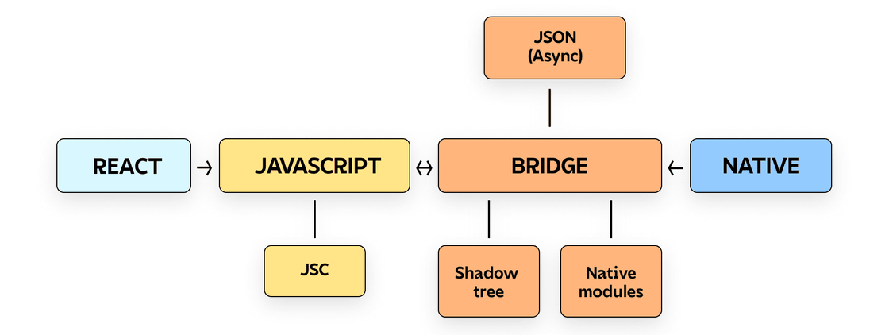
HIGH LEVEL DESIGN
SYSTEM ARCHITECTURE OF REACT NATIVE:

Slide 15
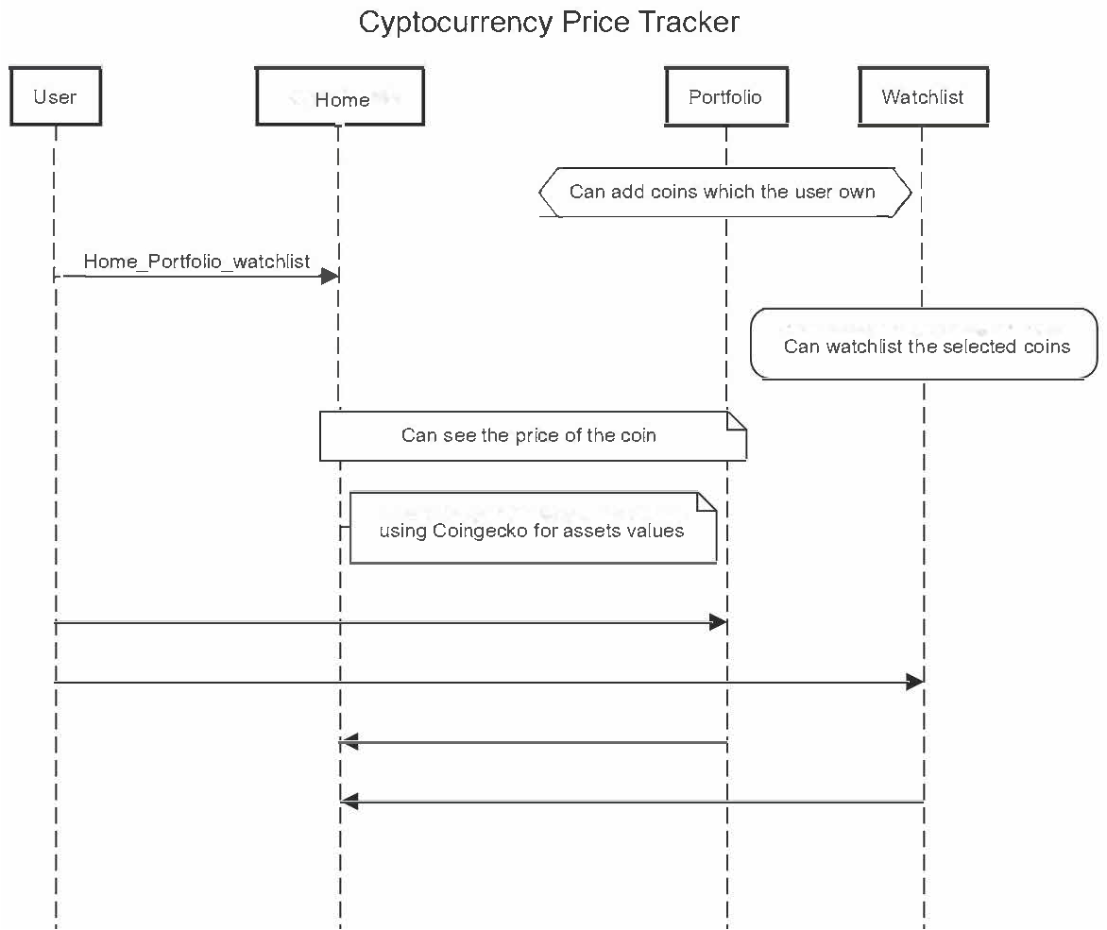
DETAILED DESIGN
SEQUENCE DIAGRAM:

Slide 16
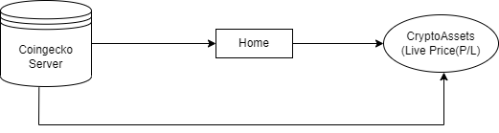
DATA FLOW DIAGRAM:
Level-0:

Slide 17
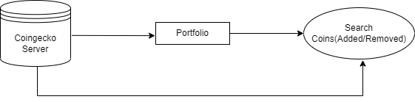
Level-1:

Slide 18

Level-2:

Slide 19
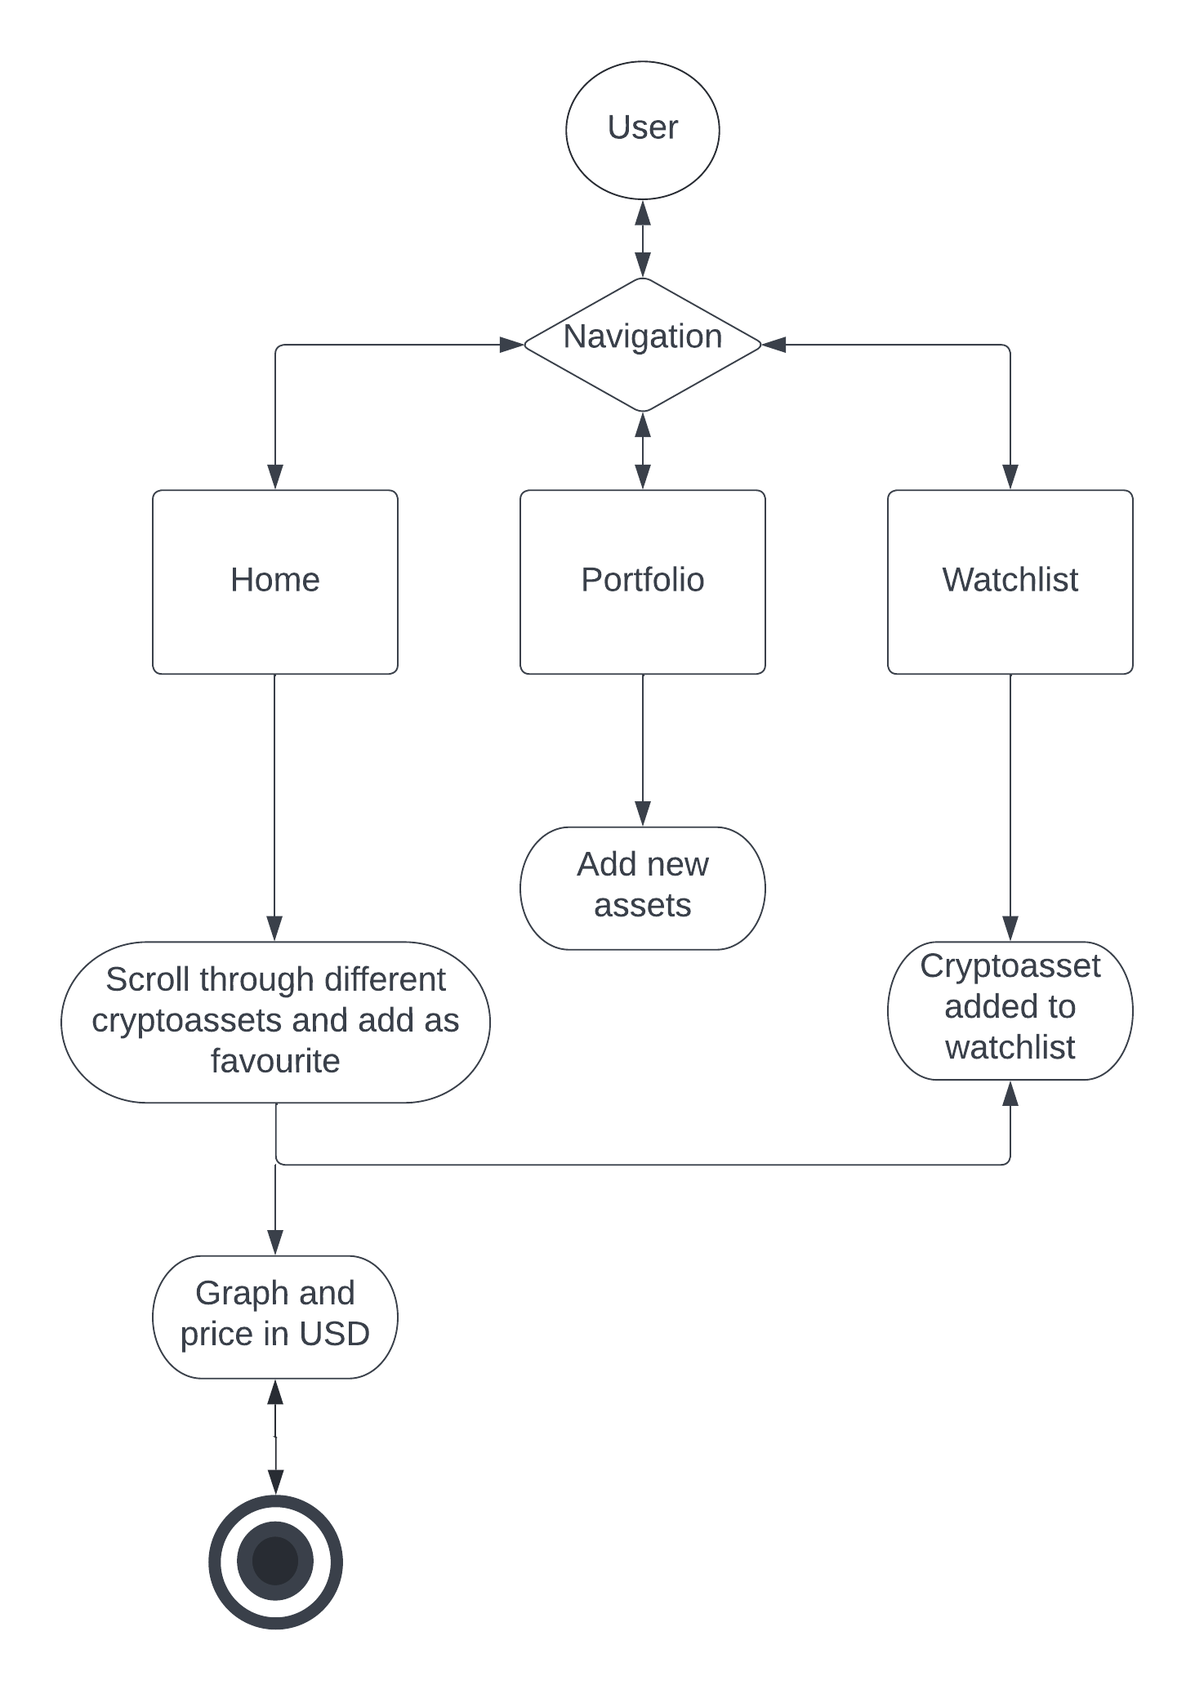
ACTIVITY DIAGRAM:

Slide 20
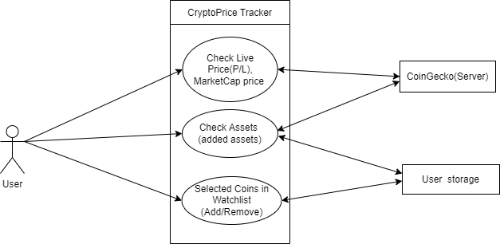
USE CASE DIAGRAM:

Slide 21
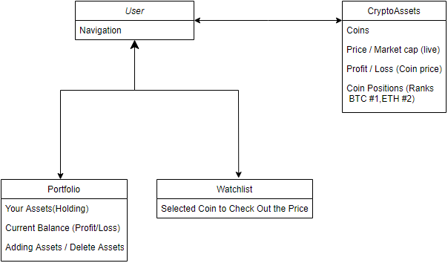
CLASS DIAGRAM:

Slide 22
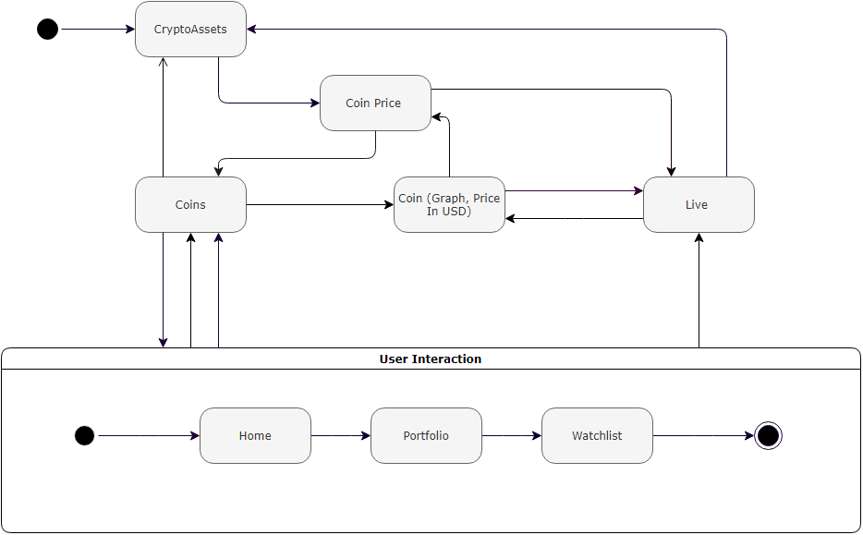
STATE DIAGRAM:

Slide 23
IMPLEMENTATION
1. Home screen
In this pseudo code we can see that the home screen
is the starting interface for the Application.
The coins are show
The coins are Fetched
Using the fetch method the coin data are fetched from the coin gecko server
const HomeScreen = () => {
const [coins, setCoins] = useState([]);
const [loading, setLoading] = useState(false);
const fetchCoins = async (pageNumber) => {
if (loading) {
return;
}

Slide 24
2.Portfolio Screen
In this portfolio screen we have the assets list of coins that Are in the server .It can choice variety of coins.
Each of the coins assets in portfolio
can be added/deleted from its list.
These Assets have style format that shows the
Assets value in a text color
const PortfolioScreen = () => {
return (
<View style={{ flex: 1 }}>
<Suspense
fallback={<Text style={{ color: "
>
<PortfolioAssetsList />
</Suspense>
</View>
);
};
export default PortfolioScreen;

Slide 25
3.Watchlist Screen
In this screen the coins that are added or stared in the Home screen can be shown in watchlist section.
These watchlist coins be removed too.
Coins that are selected by the user are shown in watchlist section.
const WatchlistScreen = () => {
const {watchlistCoinIds} = useWatchlist();
const [coins, setCoins] = useState([]);
const [loading, setLoading] = useState(false);
return;

Slide 26
4.Navigation Bar
This are the navigation bar section in which the user can navigate throw each components.
Components (Home screen)
Components (Portfolio screen)
Components (Watchlist screen)
<Tab.Screen
name="Home"
component={HomeScreen}
options={{
tabBarIcon: ({ focused, color }) => (
<Tab.Screen
name="Portfolio"
component={PortfolioScreen}
options={{
<Tab.Screen
name="Watchlist"
component={WatchlistScreen}
options={{
tabBarIcon: ({ focused, color })
</Tab.Navigator>

Slide 27
TESTING
1.BLACK BOX TESTING
Black-box testing is a method of software testing that examines the functionality of an application without peering into its internal structures or workings. This method of test can be applied virtually to every level of software testing: unit, integration, system and acceptance.
2.WHITE BOX TESTING
White-box testing is a method of software testing that tests internal structures or workings of an application, as opposed to its functionality. In white-box testing an internal perspective of the system, as well as programming skills, are used to design test cases.
3.GREY BOX TESTING
Greybox testing is a software testing method to test the software application with partial knowledge of the internal working structure. It is a combination of black box and white box testing because it involves access to internal coding to design test cases as white box testing and testing practices are done at functionality level as black box testing.

Slide 28
4.FUNCTIONAL TESTING
Functional testing is a type of testing that seeks to establish whether each application feature works as per the software requirements. Each function is compared to the corresponding requirement to ascertain whether its output is consistent with the end user's expectations.
5.END-TO-END TESTING
End-to-end testing, also known as E2E testing, is a methodology used for ensuring that applications behave as expected and that the flow of data is maintained for all kinds of user tasks and processes.End-to-end testing is a technique that tests the entire software product from beginning to end to ensure the application flow behaves as expected.
6.PERFORMANCE TESTING
Performance testing is a testing measure that evaluates the speed, responsiveness and stability of a computer, network, software program or device under a workload. We will do performance testing once the software is stable and moved to the production, and it may be accessed by the multiple users concurrently, due to this reason, some performance issues may occur.

Slide 29
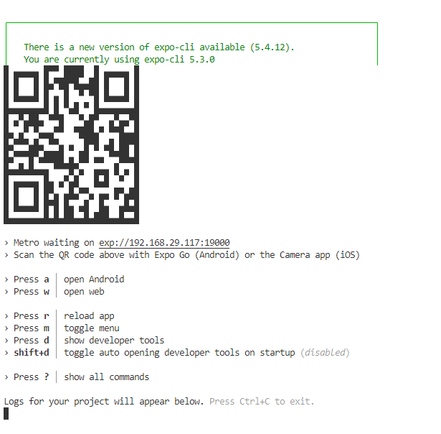
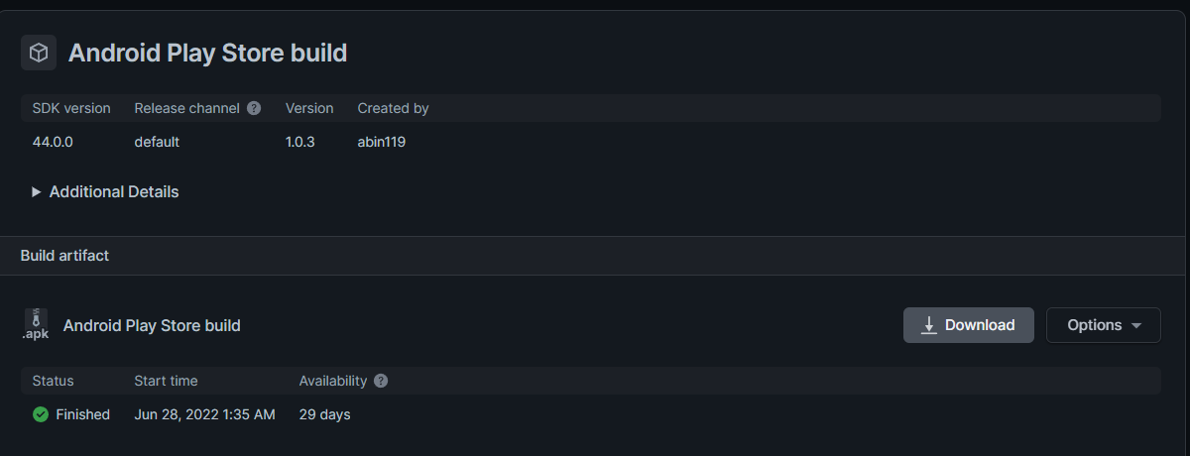
Export Testing : ANDROID
Test Name | Export To Android
Test Description | Used Expo to Export the code to APK
Input | Expo Build Android
Output | Exported it to APK Format
Result | Success

Slide 30
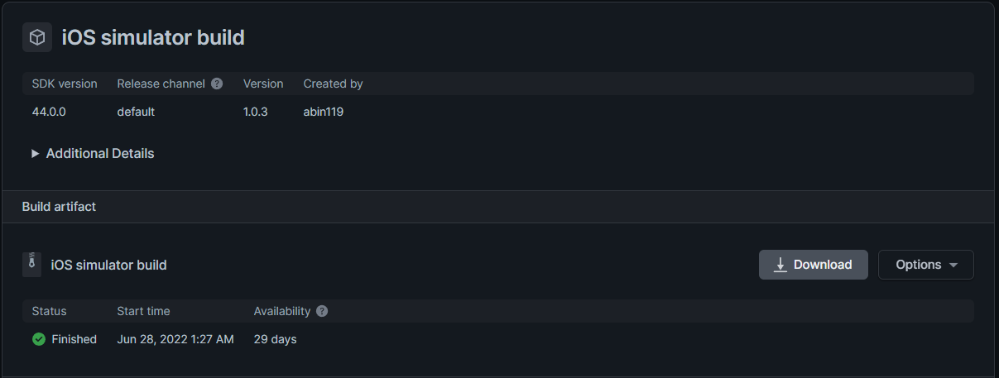
Export Testing : IOS
Test Name | Export To IOS
Test Description | Used Expo to Export the code to IOS build
Input | Expo Build IOS
Output | Exported it to IOS build (IPA)Format
Result | Success

Slide 31
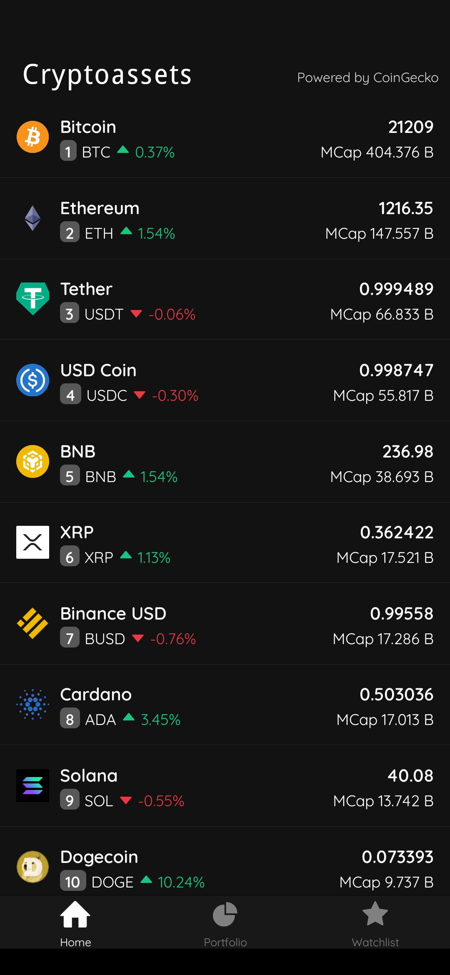
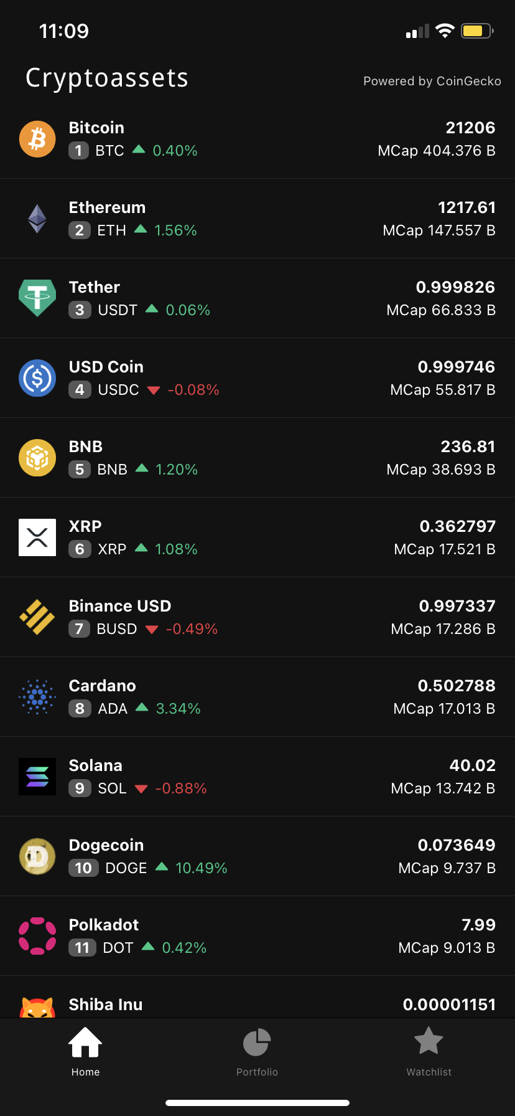
SNAPSHOTS
ANDROID
IOS

Slide 32
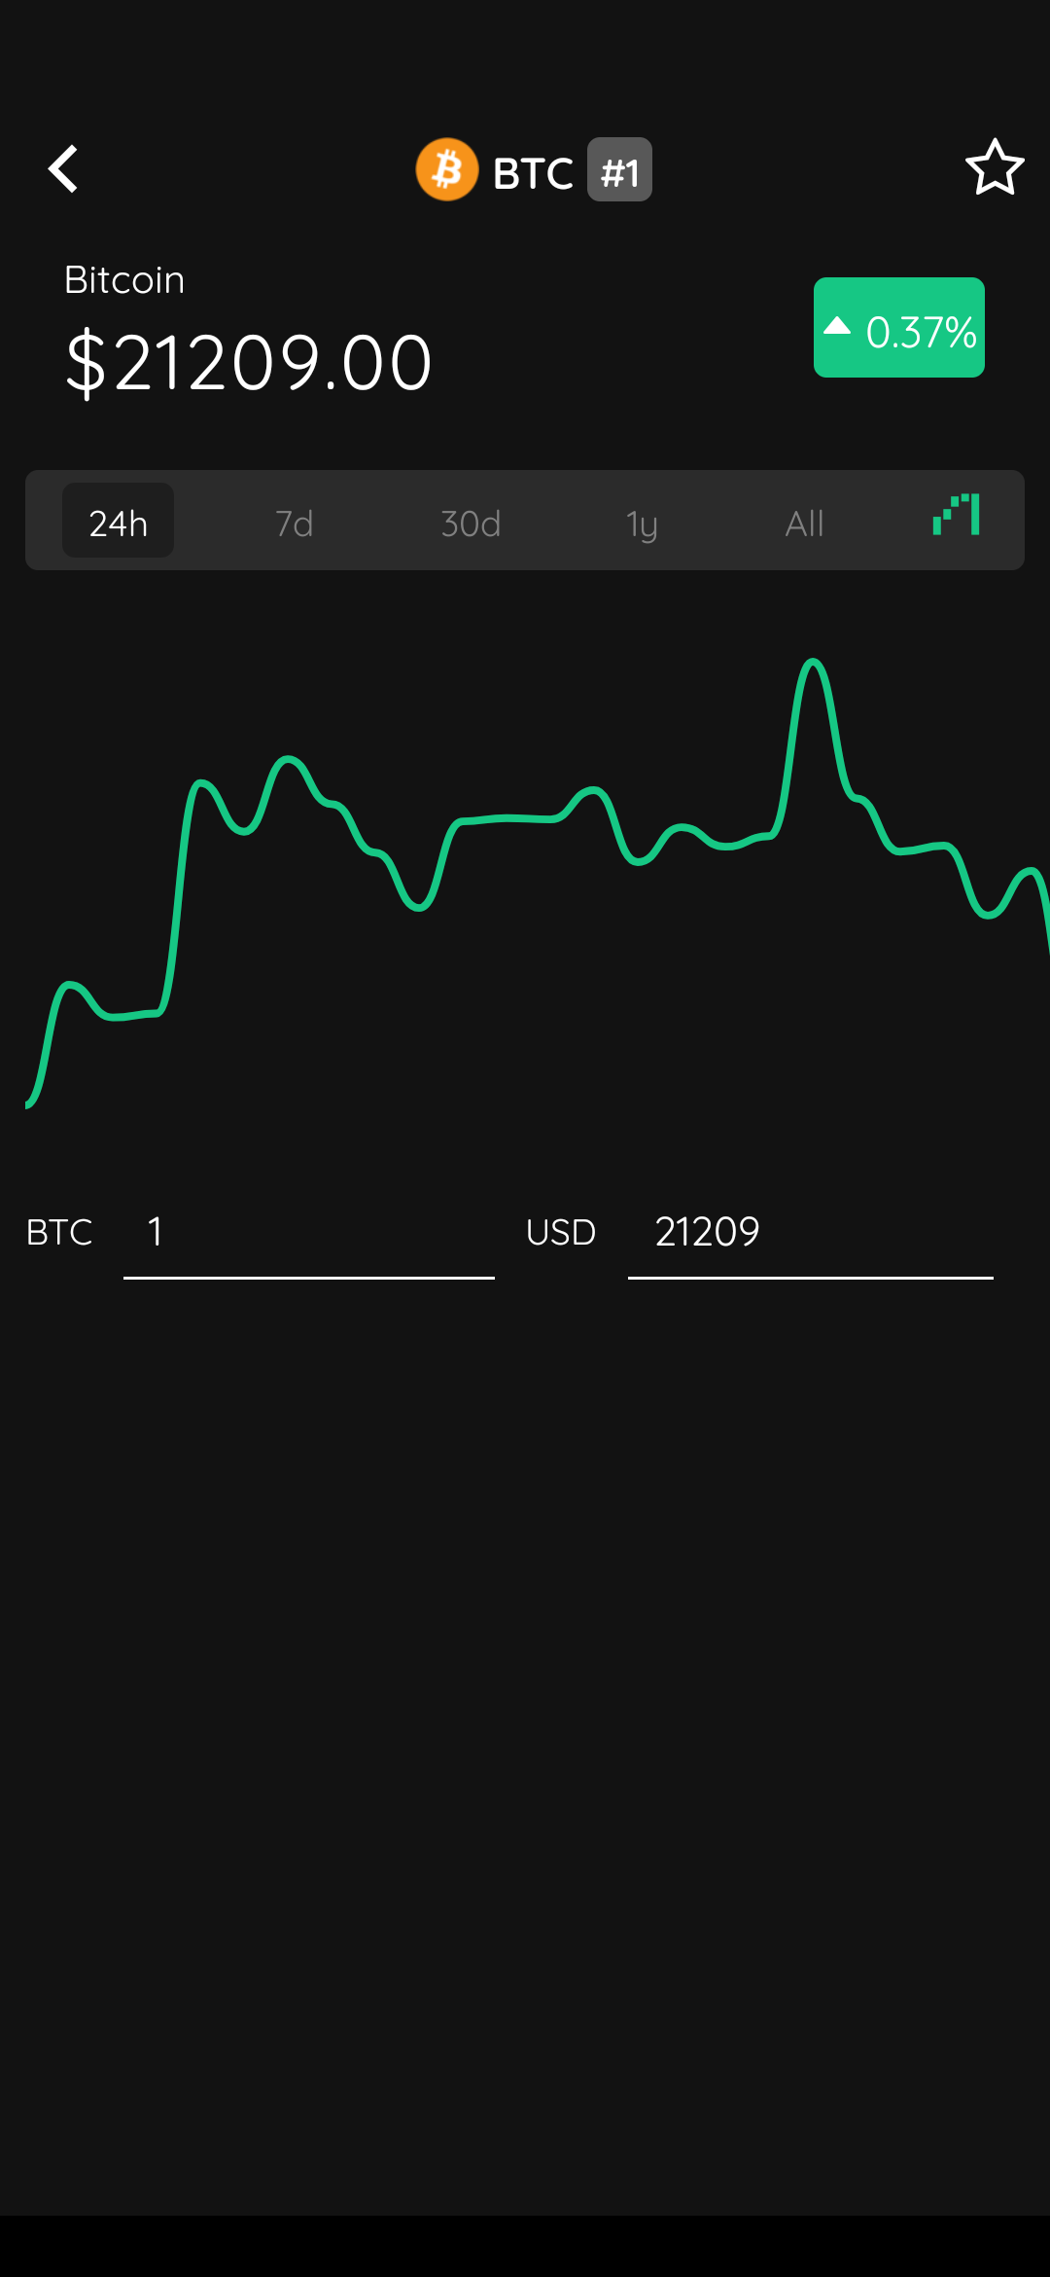
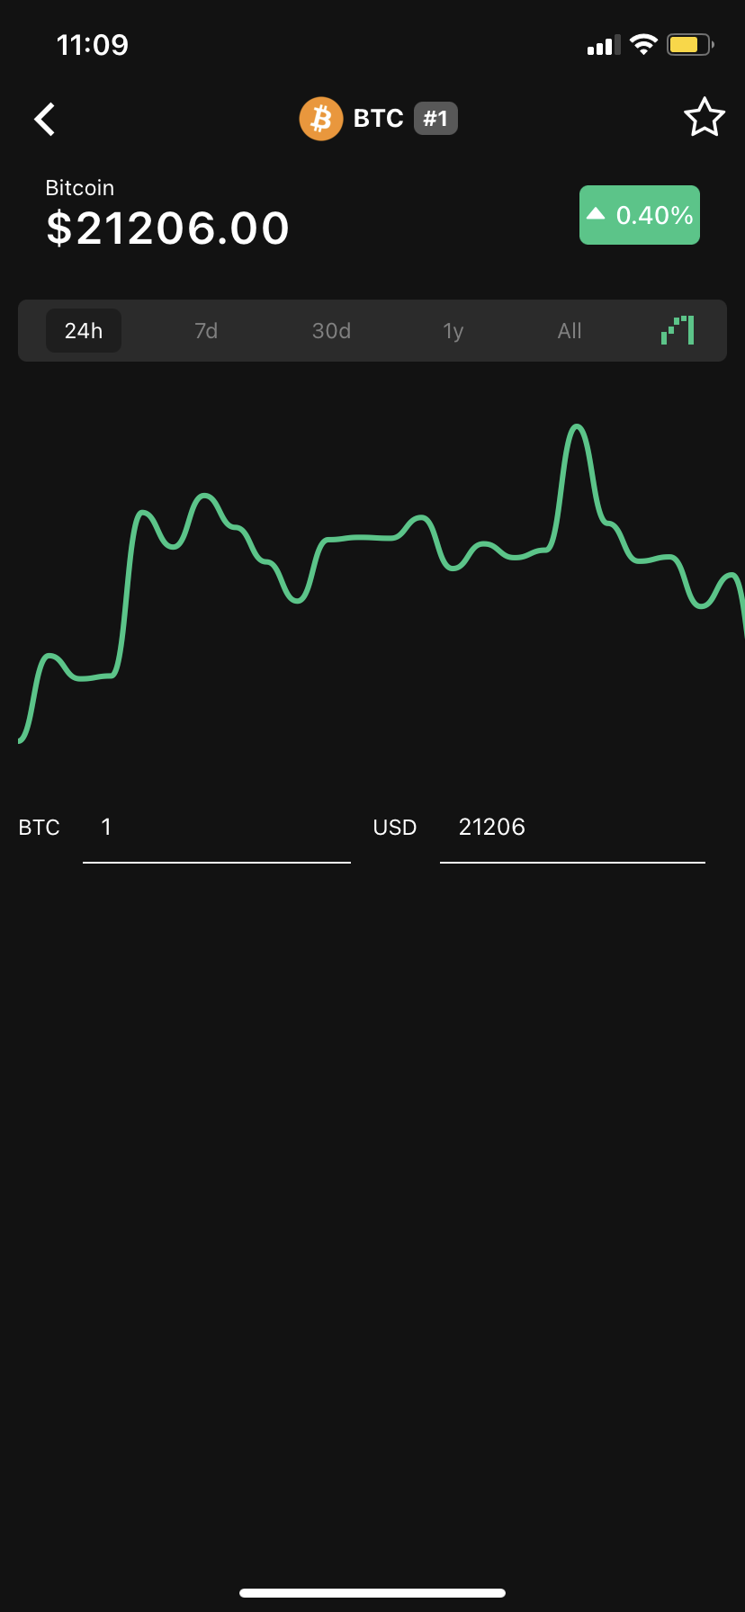
ANDROID
IOS

Slide 33
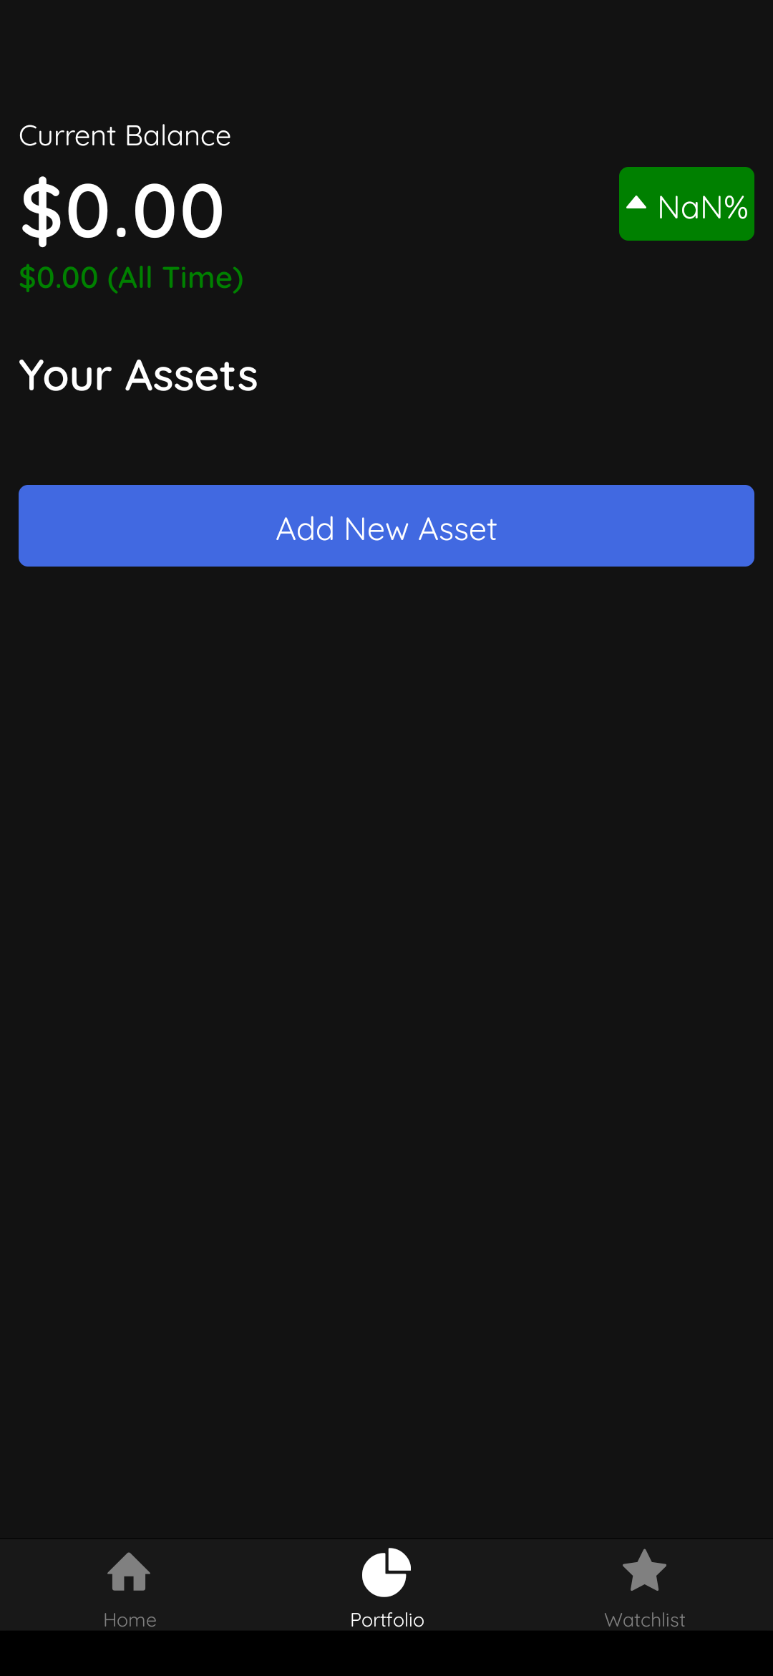
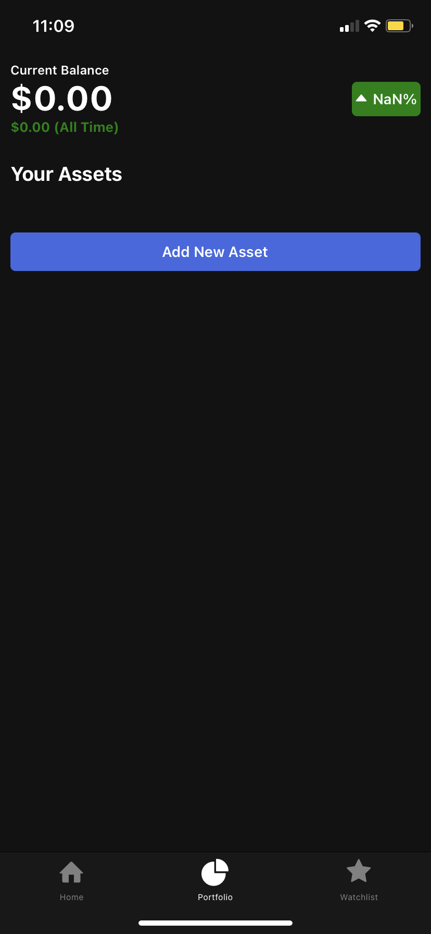
ANDROID
IOS

Slide 34
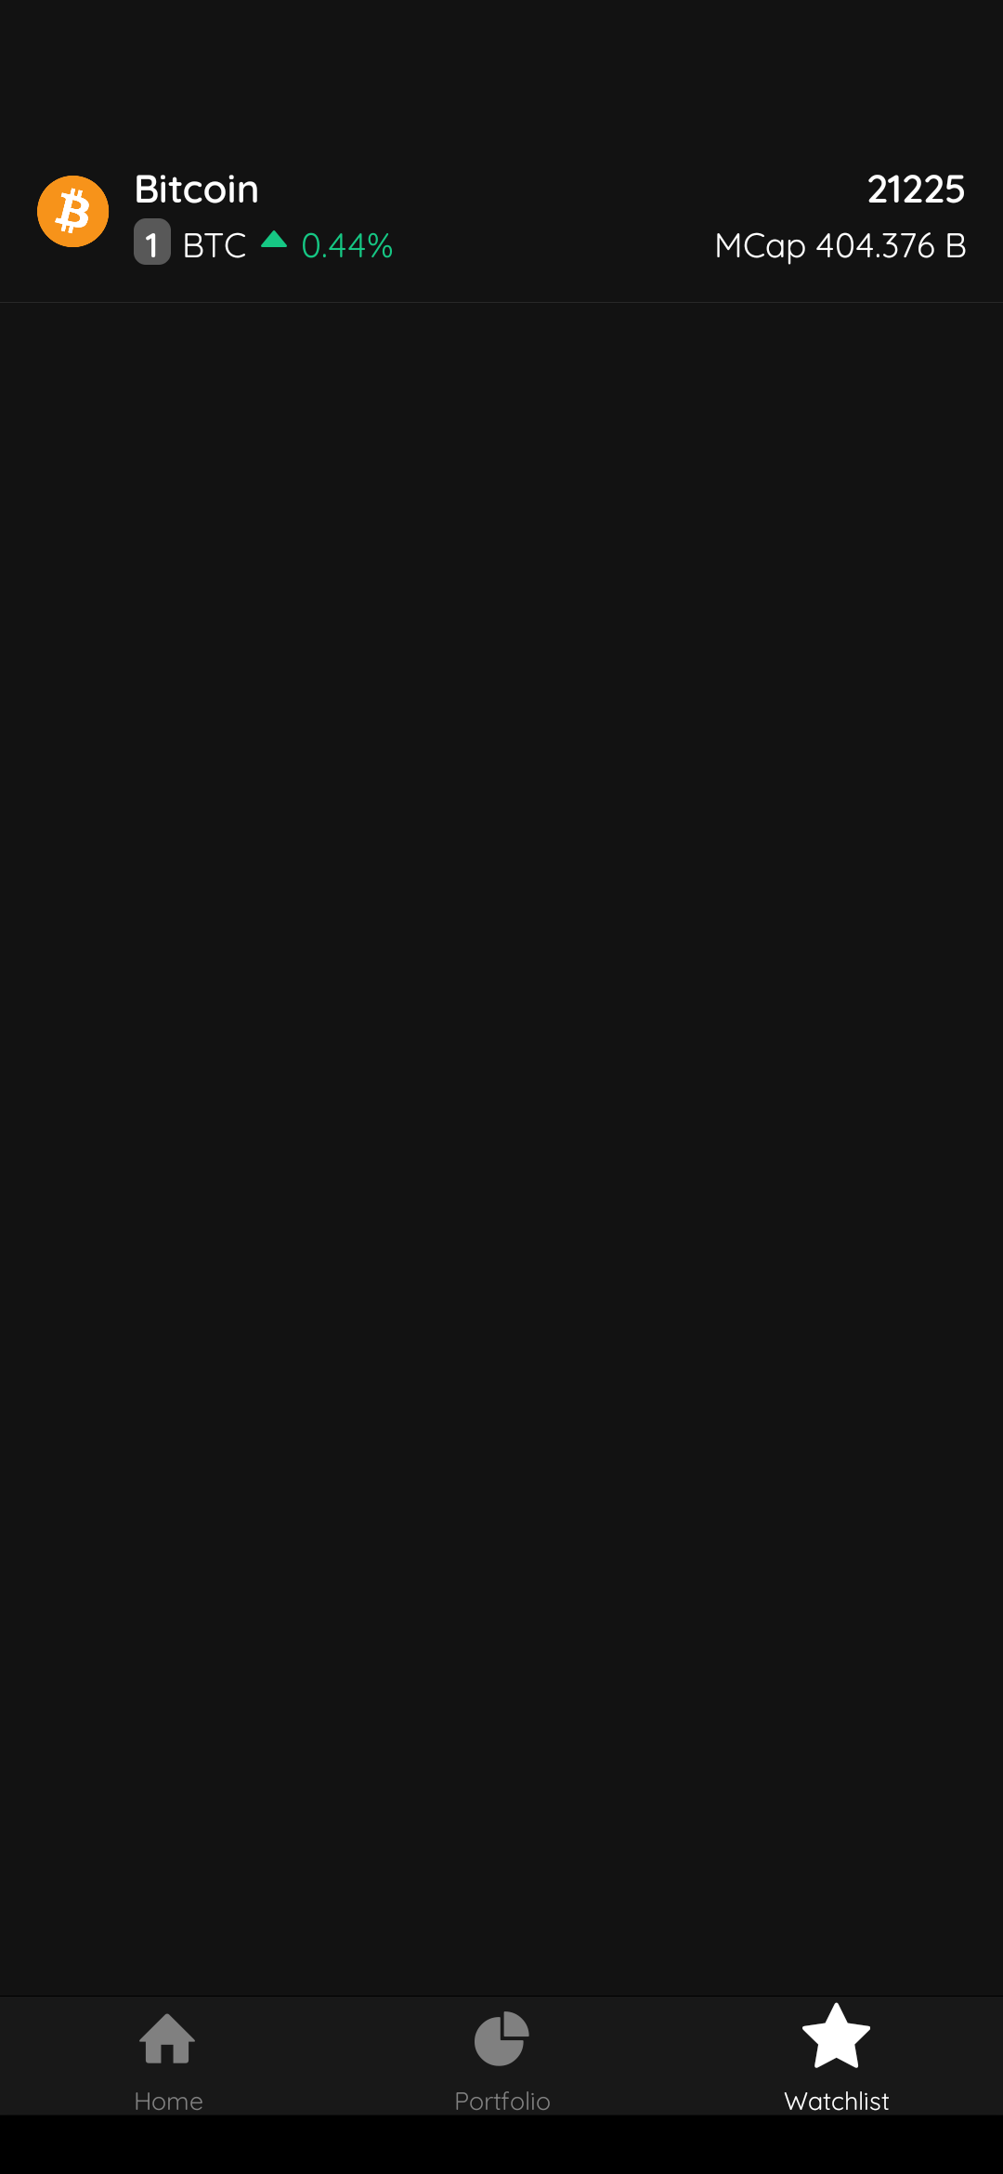
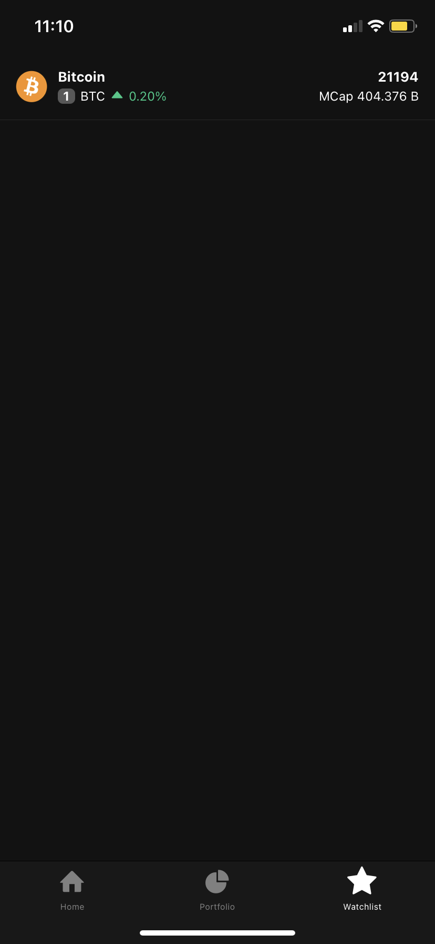
ANDROID
IOS

Slide 35
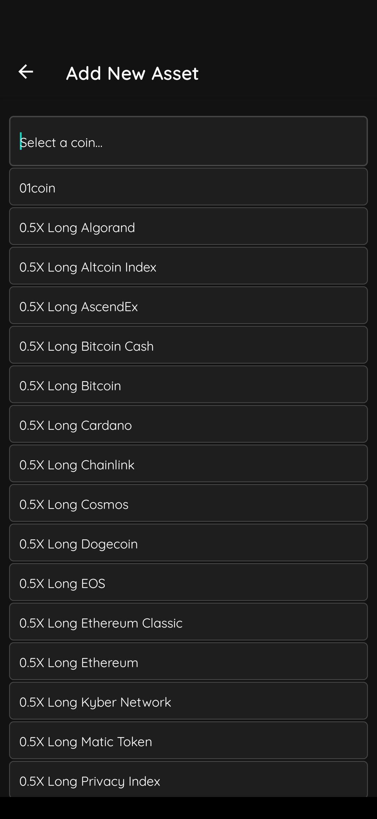
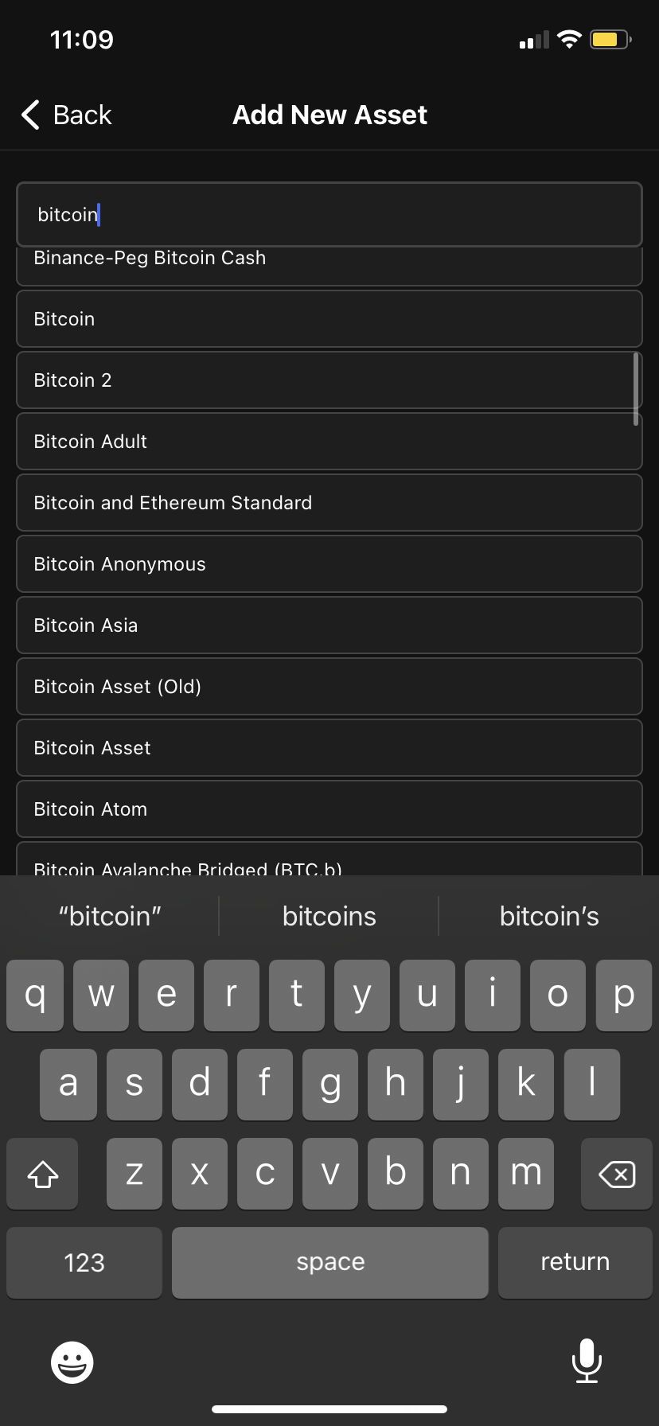
ANDROID
IOS

Slide 36
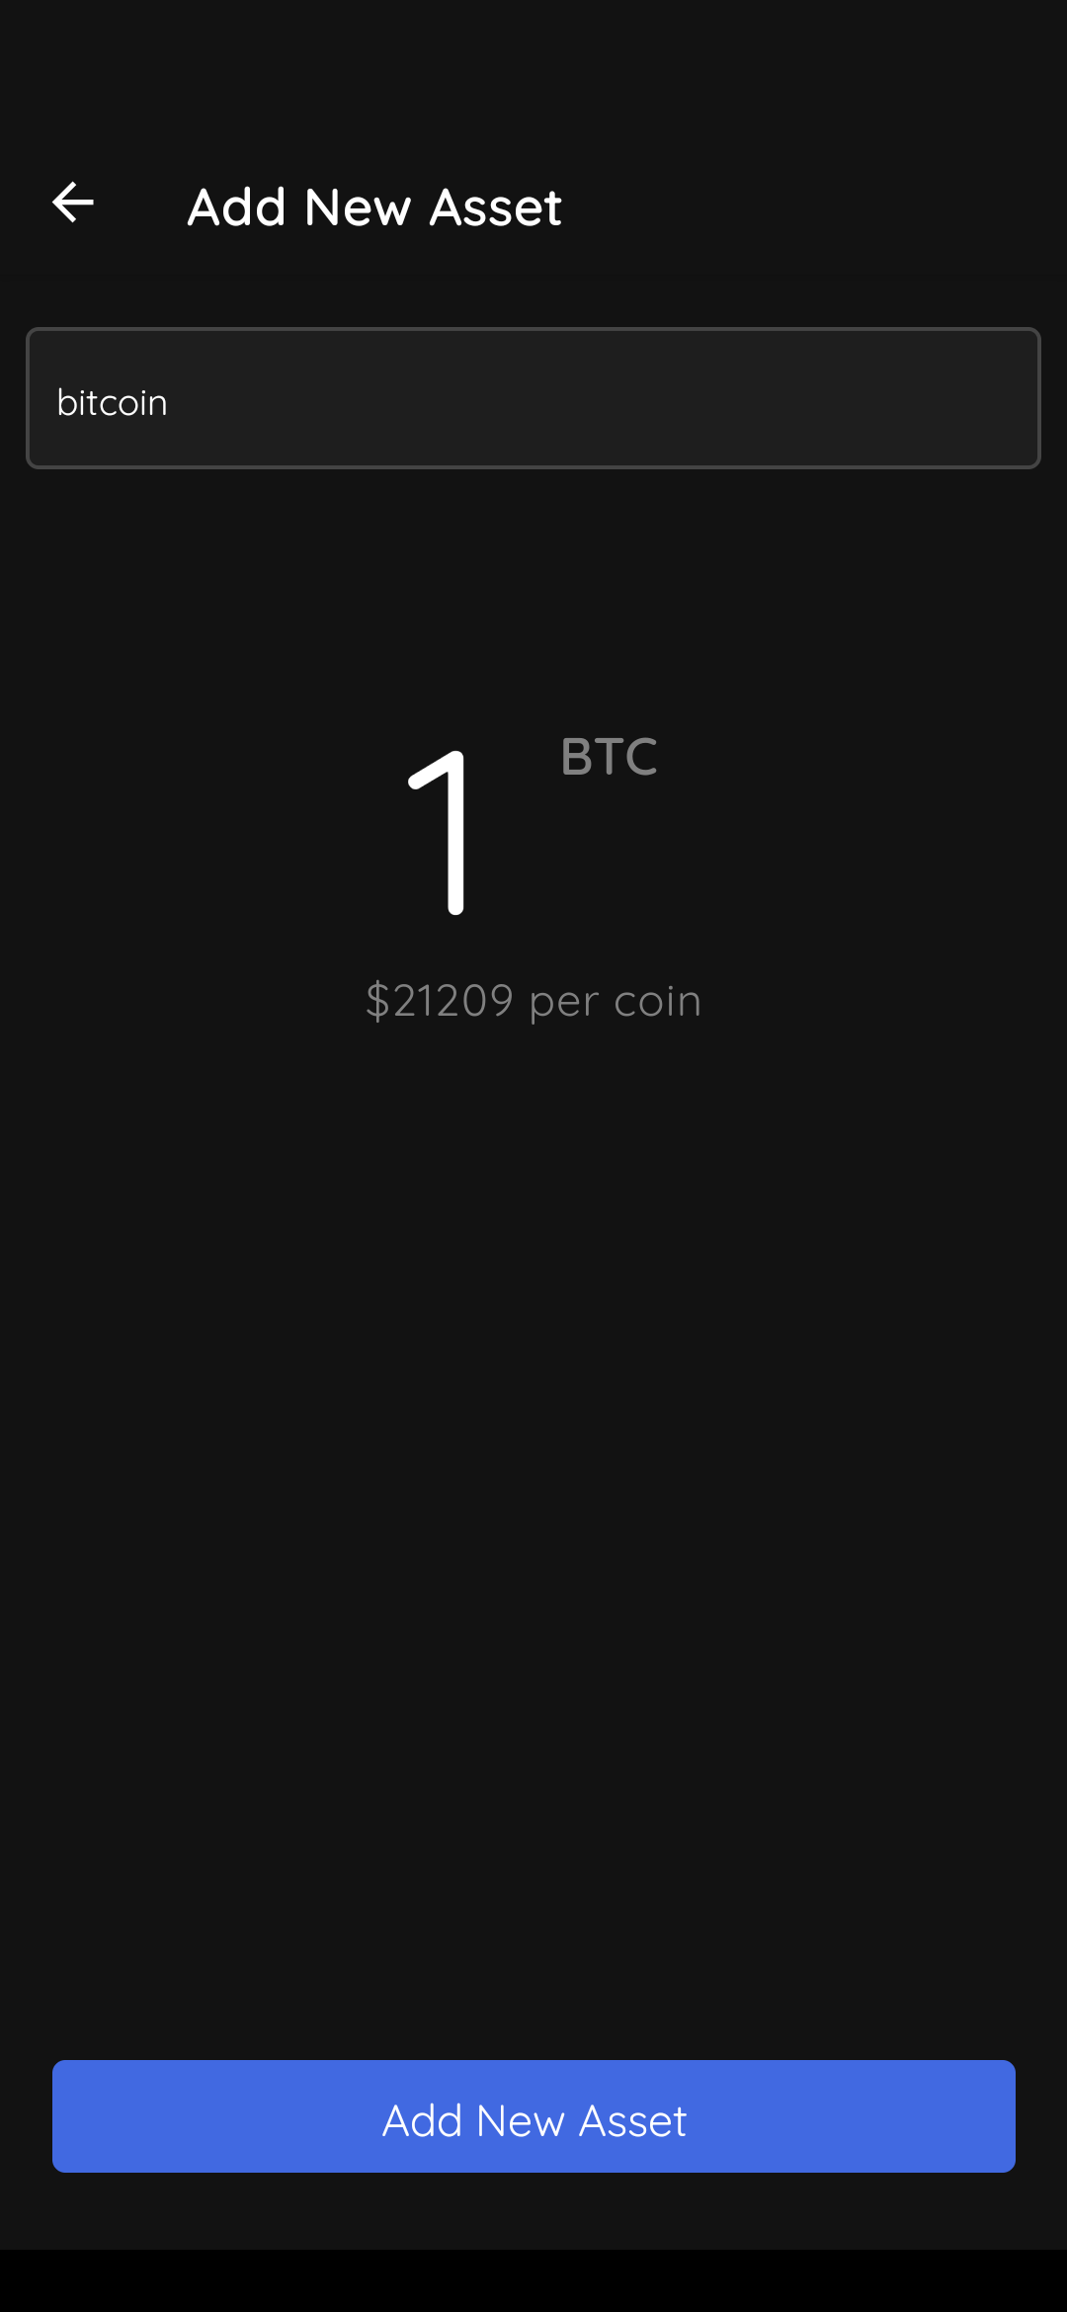
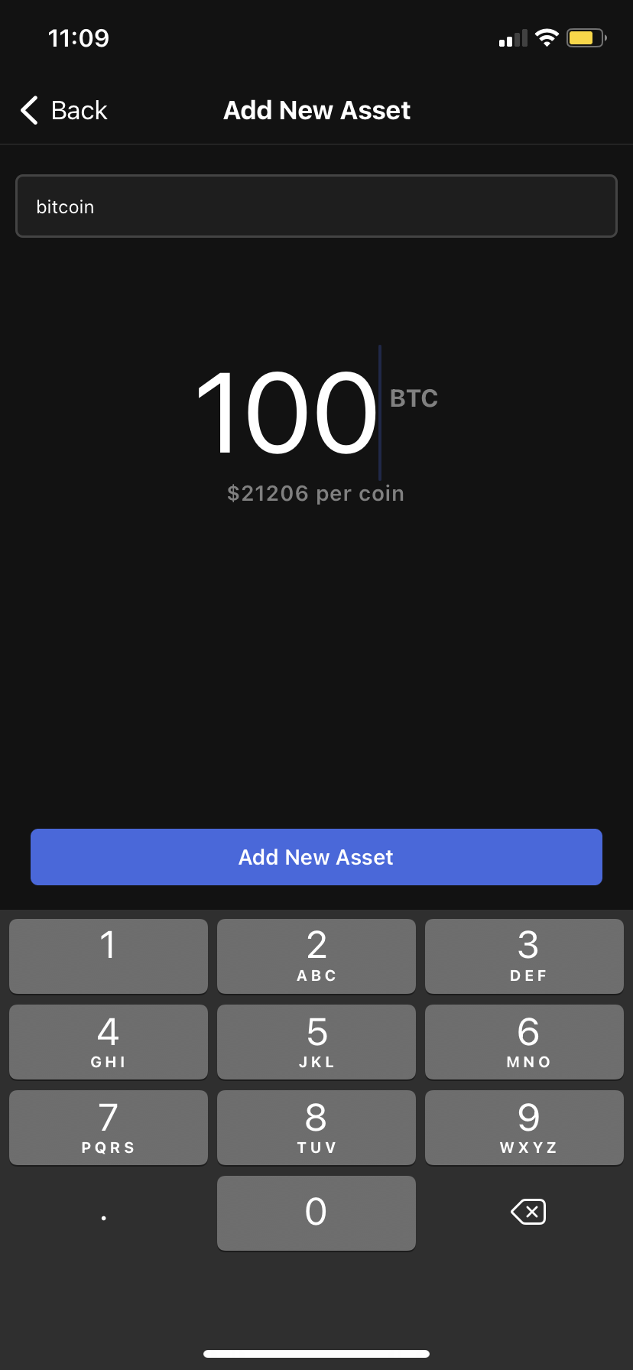
ANDROID
IOS

Slide 37
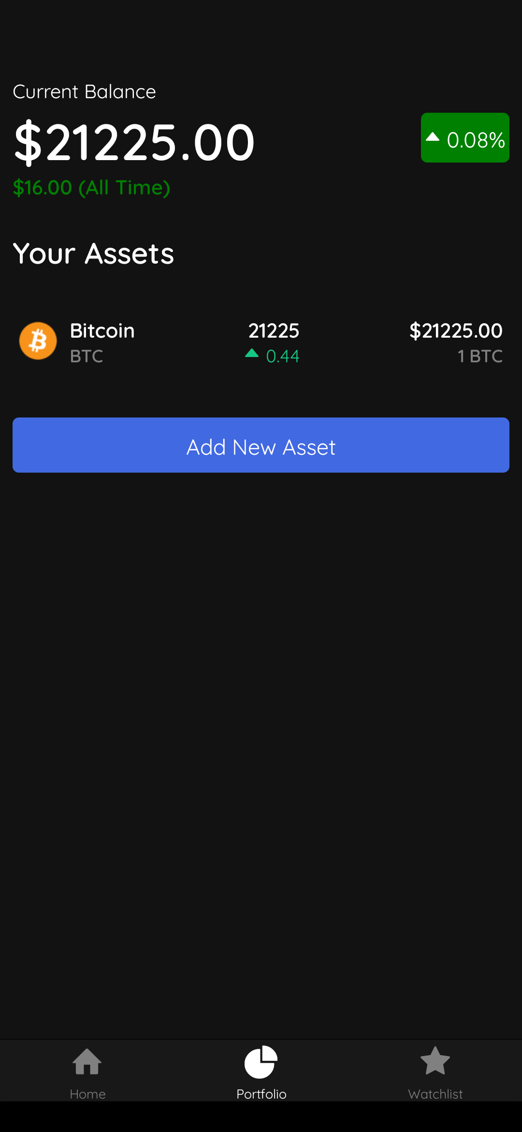
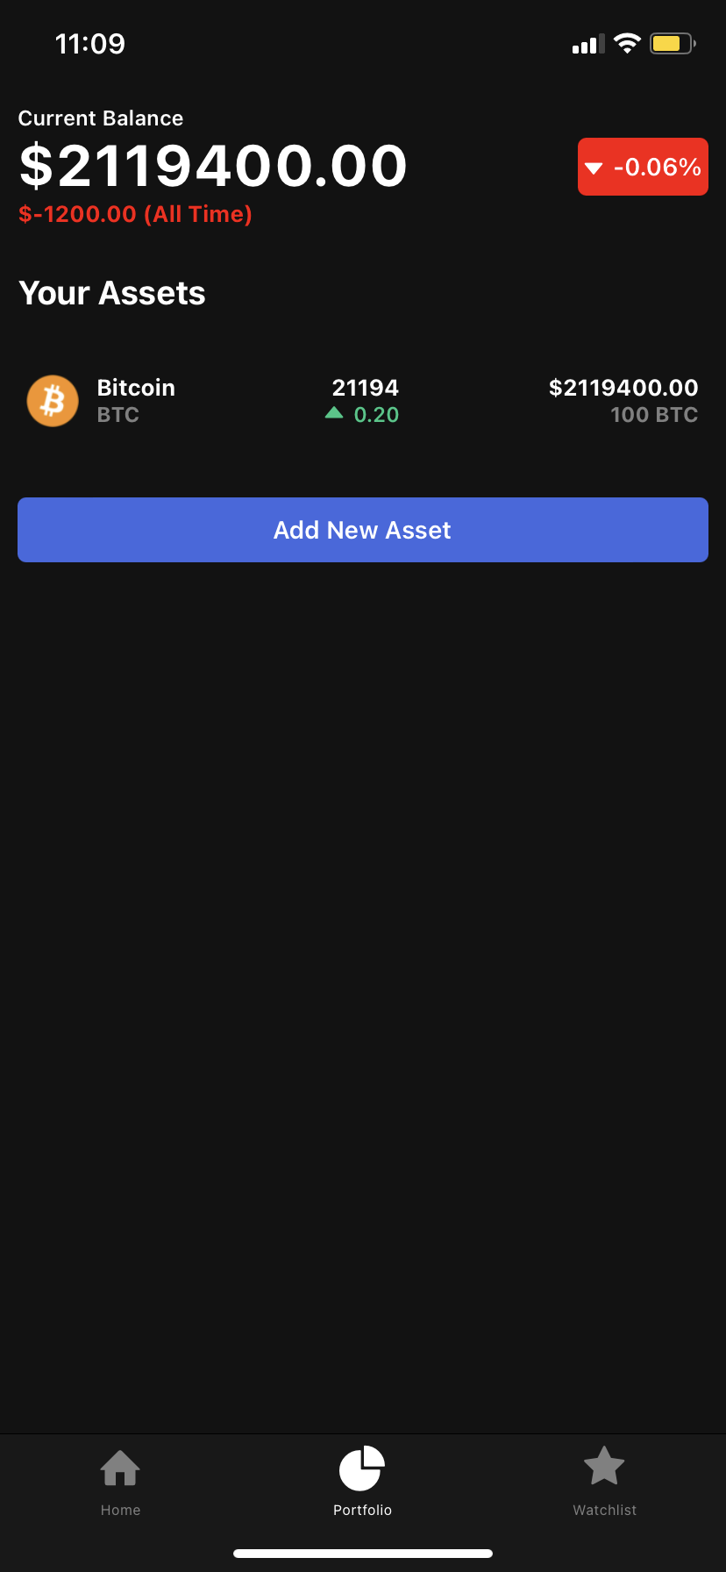
ANDROID
IOS

Slide 38
RESULT
By using a single programming language (JavaScript) we have created an application which works on Both the Mobile Operating Systems(Android, IOS) by using React Native Framework. The application works fine on both the operating systems with no issues and as the application is written in JavaScript code which is common for both the operating systems, installing the application in both IOS&ANDROID device is done using Expo that Exports this application to APK format for android and for ios Build (IPA) format.

Slide 39
CONCLUSION
Cross-platform mobile development is not a clear winner of native app against cross- platform app development opposition. At the same time, it has lots of significant advantages that make the approach the only possible solution for certain types of startupers.
Cross-platform development is faster, cheaper, and easier. It is a perfect tool to test the startup idea or present it to investers before assigning money in native app development. In addition, it works perfectly for sustainable corporate apps.
There are also a couple of arguments against multi-platform mobile app development. Cross-platform apps usually have lower operating speed and responsiveness, poor UX and UI, and may not support hardware features.
Another frequent criticism is its inseparability from the framework the app is built with. Once you’ve created an app using Xamarin or React Native, you’ve got no chances to use the same code within another framework.
Remember, that apart from cross-platform apps there are hybrid (cheap, but not suitable that much for hardware features integration) and progressive web apps (good for eCommerce).

Slide 40
FUTURE ENHANCEMENT
The future of cross-platform app development looks promising. However, with the rise in popularity, there is no telling what we can expect to see come into fruition in years ahead!
For the future,
1.We decided to add wallet Id in the blockchain (private / public) key for the user to transfer their crypto assets from one id to another id.
2.In the application we can buy/sell crypto assets.
3.We have decided to use this application for the web3 based authentication.
4.Use of AI&ML for the price predication automatically without any false errors.

Slide 41
REFERENCES
[1].Cider: Native Execution of iOS Apps on Android, Jeremy Andrus, Alexander Vant Hof, Naser AlDuaij, Christof-fer Dall, Nicolas Viennot, and Jason Nieh, IEEE Micro, 2008,Vol.1.
[2].Android Development Tools plugin for Eclipse (2012),http://developer.android.com/sdk/eclipse-adt.html.
[3].About PhoneGap (2011), http://phonegap.com/about.
[4].Heitktter, Henning, Sebastian Hanschke, and Tim A. Ma-jchrzak. ”Evaluating cross- platform development approaches for mobile.
[5].http://developer.apple.com/members.
[6].http://source.google.com.
[7].https://developer.apple.com/xcode.

Slide 42
[8] J. Christoph, D. Rösch, and T. Schuster, “Cross-Platform Development. Suitability of Current Mobile Application Frameworks,” in The Eighth International Conference on Advanced Collaborative Networks, Systems and Applications, Venice, Italy, 2018, pp. 13–20.
[9] Statista, “Internet of Things, Forecast, Number of networked devices worldwide by 2020,” Statista. [Online]. Available: https://de.statista.com/statistik/daten/studie/537093/umfrage/anzahl-der-vernetzten-geraete-im-internet-der-dingeiot-weltweit/. [Accessed: 07-Mar-2018].
[10] Statista, “Number of smartphone users worldwide 2014- 2020.” [Online]. Available: https://www.statista.com/statistics/330695/number-of-smartphone-users-worldwide/. [Accessed: 15-May-2018].
[11] L. Corral, A. Janes, and T. Remencius, “Potential advantages and disadvantages of multiplatform development frameworks–a vision on mobile environments,” Procedia Computer Science, vol. 10, pp. 1202–1207, 2012.

Slide 43
THANK YOU

